Slide 1
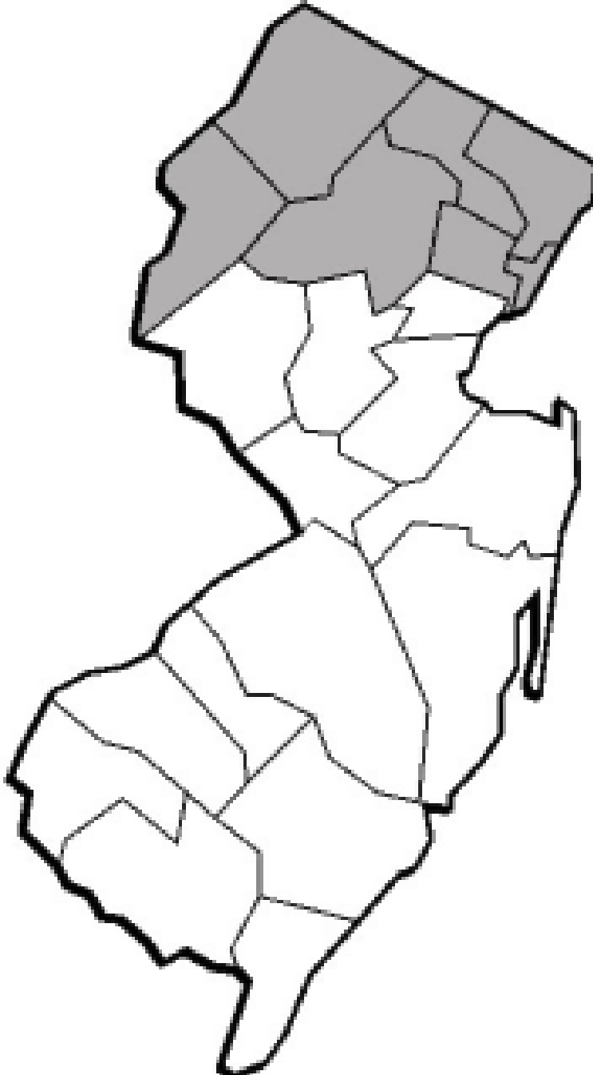
North Jersey School Music Association
Region I of the New Jersey Music Educators Association
www.njsma.org
General Membership Meeting
February 24, 2023
Atlantic City Convention Center - Room CC418
Christopher J. DeWilde, NJSMA President

Slide 2
About us
Affiliate of NJMEA
Operate under the umbrella of NJMEA
Closest local link to NJMEA & NAfME
Have separate Bylaws & Constitution
Seven northern counties in the state
Bergen, Essex, Hudson, Morris, Passaic, Sussex & Warren
Represent all music educators who are members of NAfME
Band, Choir, General Music, Guitar, Music Technology, Non-Traditional Ensembles & Orchestra

Slide 3
Executive Board
Consists of:
Elected Positions
President, President-Elect, Past-President
Treasurer
Publicity/Corresponding Secretary
Recording Secretary
Appointed Positions (By the President)
Division Chairpersons
Webmaster
One meeting a month to discuss approvals, events and policy

Slide 4
Teacher Volunteers
What do they do?
Coordinate Festivals, Ensembles & Professional Development
Manage, Host & Audition Chairperson
Manage judging and other assigned duties on audition days/rehearsals
Many people needed to work together
Networking opportunities

Slide 5
What we provide for the Students …….
Honors Ensembles
Audition based
Directors serve as judging panel
Performance Opportunities
Festivals for your groups
Non-competitive/Competitive critiqued performances
Respected authorities in specific disciplines of music performance
Scholarships
Offered to graduating seniors going to to major in music in college

Slide 6
What we provide for the Directors ..…..
General Membership Meetings
Divisional meetings at region auditions (January & February)
Today ……. General Membership meeting
Tuesday, June 6, 2023 – Annual PD Day
Workshops for General Music, Band, Choir, Orchestra and other topics
Free for all NJSMA members
Light breakfast and catered lunch
Hear scholarship winners
Keynote speaker
Elections (president elect and recording secretary are up for election this year)
Professional development workshops
We are a resource for our members, please don’t hesitate to reach out.

Slide 7
President, Past President & President Elect
President - Presides at all general meetings of the association and of the
executive committee. They shall be chairperson of all North Jersey School Music Association activities. The President shall act as liaison with the board of directors of NJMEA and shall serve on said board.
Past President - Shall serve as advisor to the President and shall assume
duties as assigned by the President. They may assume President duties in the event that the President Elect is not available.
President Elect - Shall assume all the duties of the President in case of
absence of the President and shall assume duties as assigned by the President. The president elect also serves in an advisory role to the entire executive board.

Slide 8
Past President
Scholarship
Criteria
Application details
Selection process
Performance by recipients
* All details emailed to HS directors and posted on NJSMA
website under Scholarships

Slide 9
Treasurer
Executes all financial transactions
Deposits all funds in bank
Disperses funds as directed by the Executive Board or special authorization by the president
Coordinates with an accountant for tax filing
Presents a report at annual meeting

Slide 10
Webmaster
Designs & maintains the NJSMA.org website
Distributes @NJSMA.org emails for board members & chairpersons
Posts urgent updates to home page
*Please note NJSMA.com is now NJSMA.org and all Region I email addresses now end in @NJSMA.org. For any questions or problems with anything on NJSMA.org, please contact webmaster@njsma.org.

Slide 11
Publicity/Corresponding Secretary
All emails are coming from Constant Contact via the Publicity@njsma.org
email address
If you are not receiving or know a Region 1 member who is not receiving
emails please try using the “Contact Update Form” found on our
homepage: NJSMA.org
If you are still having issues with receiving emails after filling out the
contact form please reach out to me directly at: Publicity@njsma.org
Thank you!
Natalie Kerr
Corresponding Secretary
Bloomfield High school

Slide 12
Diversity & Inclusion
Mission:
To increase access and participation by identifying systemic obstacles, generating solutions, and supporting music educators in non-standard music disciplines and under-resourced schools.
Join our *NEW* IDEA Committee!
email diversity@njsma.org
What We Do:
Oversee fee waivers and transportation support for regional events.
Organize professional development and supports (e.g., free masterclasses).
Develop and lead opportunities including the 1st Generation College Fair, Non-Standard Ensemble Festival, etc.
…and more!!!

Slide 13
Elementary General Music Division
The NJSMA Elementary General Music Division is proud to offer exceptional events and workshops
for elementary general music educators.
2022-2023 Events:
*October 10, 2022: Fall Workshop
Amy Abbott - Guest Clinician
*April 1, 2023: It’s Elementary, My Dear Workshop
Co-Sponsored with New Jersey Youth Chorus
*May 31, 2023: Elementary Choral Celebration
Guest Clinicians: Dr. Nick McBride, TCNJ and Prof. Sarah Michal, Drew University
*June 6, 2023: NJSMA PD Day
Guest Clinicians for Elementary General Music announced soon!
Join our mailing list:
elementary@njsma.org

Slide 14
Chorus Division
We offer Intermediate and High School Region Chorus Events along with Adjudicated Intermediate and High School Chorus Festivals (non-competitive).
HS & Intermediate Treble Chorus
HS & Intermediate Mixed Chorus
Grades 6 - 12
We are always looking for assistance to help our division run smoothly. If you are interested to serve in ANY way (manager, host, piano accompanist or division co-chair) please contact us at chorus@njsma.org
Upcoming Events: Intermediate Region Chorus Concert: Sunday 3/26/23
Professional Development: Tuesday 6/6/23

Slide 15
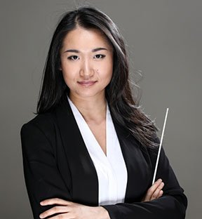
Orchestra Division
We offer events for Elementary, Intermediate (MS), and High School (HS)
HS Symphonic Orchestra (grades 9 - 12)
Intermediate String Orchestra (grades 6 - 8)
Elementary Festival (grades 4, 5, 6)
We are always looking for more directors to get involved!
Expanded program (looking to add for 23-24)
HS Chamber Festival
MS Nomination Festival
HS Nomination Festival
Please email us orchestra@njsma.org with any questions.
Upcoming events:
Intermediate Orchestra Concert - 3/5 3:00PM at County College of Morris
Elementary Festival - 4/29 < msg elemorch@njsma.org
Jiannan Cheng (Rowan)
Director for HS 23-24

Slide 16
Band Division
Co-Chairs:
Michelle Christianson - Parsippany Hills HS
Lew Kelly - West Orange HS
Lyn Lowndes - Richard Butler MS
What we do:
High School Auditions and Concert (grades 9-12)
Symphonic Band & Wind Ensemble
Intermediate Auditions and Concert (grades 7-9) - Concert March 12 at John H. Walker MS
Concert Band & Symphonic Winds
High School Concert Band Festival w/ clinic - March 21-23, multiple locations
Middle School Concert Band Festival w/ clinic - April 26 at Pequannock HS
Elementary Honors Band Festival (5th & 6th grade) - May 6 at Mount Olive HS
We are always looking for:
audition chairs
ensemble managers
site hosts
event coordinators
conductors
Please email band@njsma.org if you have any questions or are interested in helping out!

Slide 17
To conclude …….
Great way to get involved and give back to the region
Many of you were probably involved as a student
We can’t do this without the general membership
Contact anyone on the board
Be part of a great team
Provide the students of North Jersey with the best musical experiences

Slide 19
PLEASE VISIT OUR WEBSITE FOR INFORMATION, RESOURCES AND CONTACTS
NJSMA.ORG

Slide 20
